Slide 1
Developing ChatBot 1-2 Web App in the Market Places
Refresh-Foods Inc.
Yestin Yehoon Lee

Slide 2
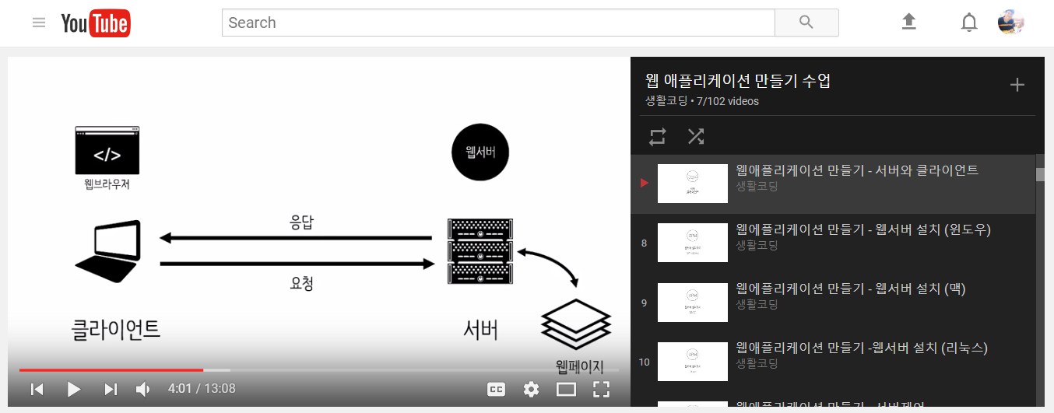
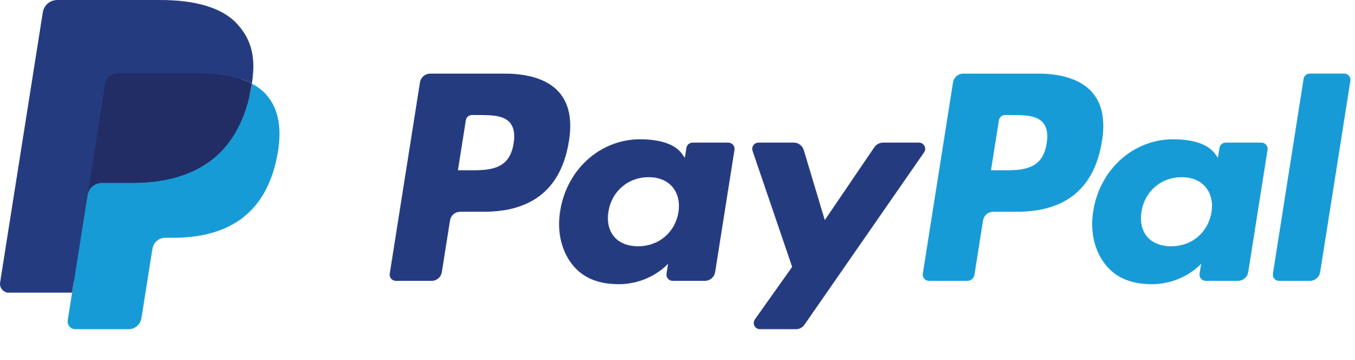
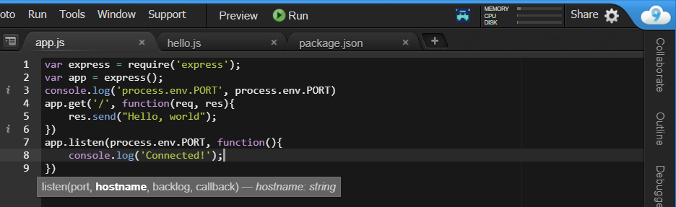
Example of Web App in Market Places
Youtube
PayPal
Cloud9
Notes:
Youtube - Each day users watch a billion hours of video. (according to Google)
PayPal - Revenue Increase US$10.84 billion (2016)
Cloud9 – Online integrated development environment, written in JavaScript and Node.js

Slide 3
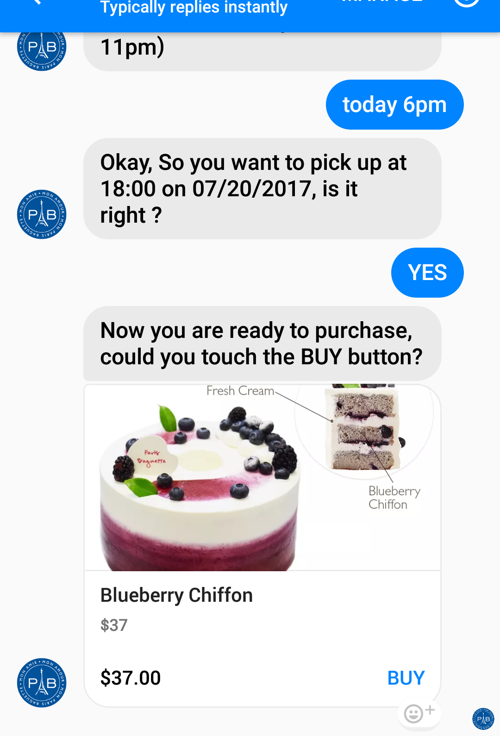
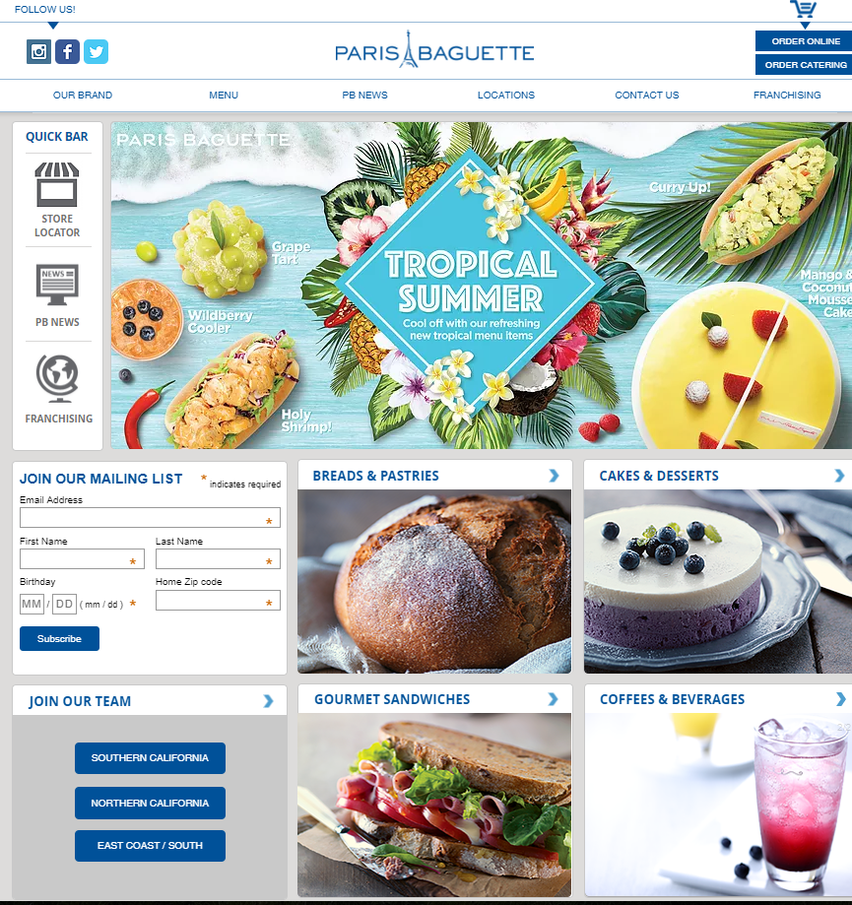
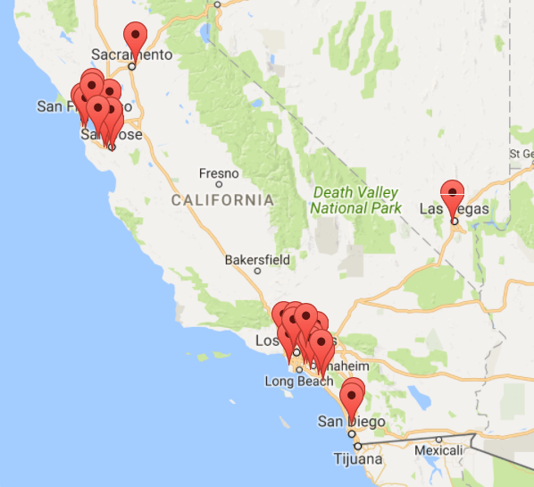
ChatBot in PB
Paris Baguette
3,500 locations over the world
Notes:
Food company sells cake by ChatBot
ChatBot is not limited in Internet company
Everyone can boost their business by ChatBot

Slide 4
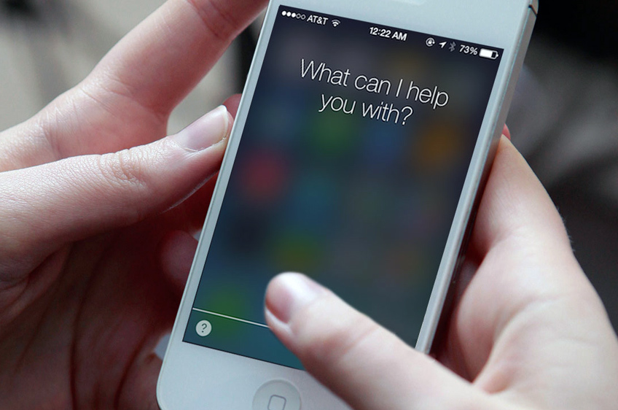
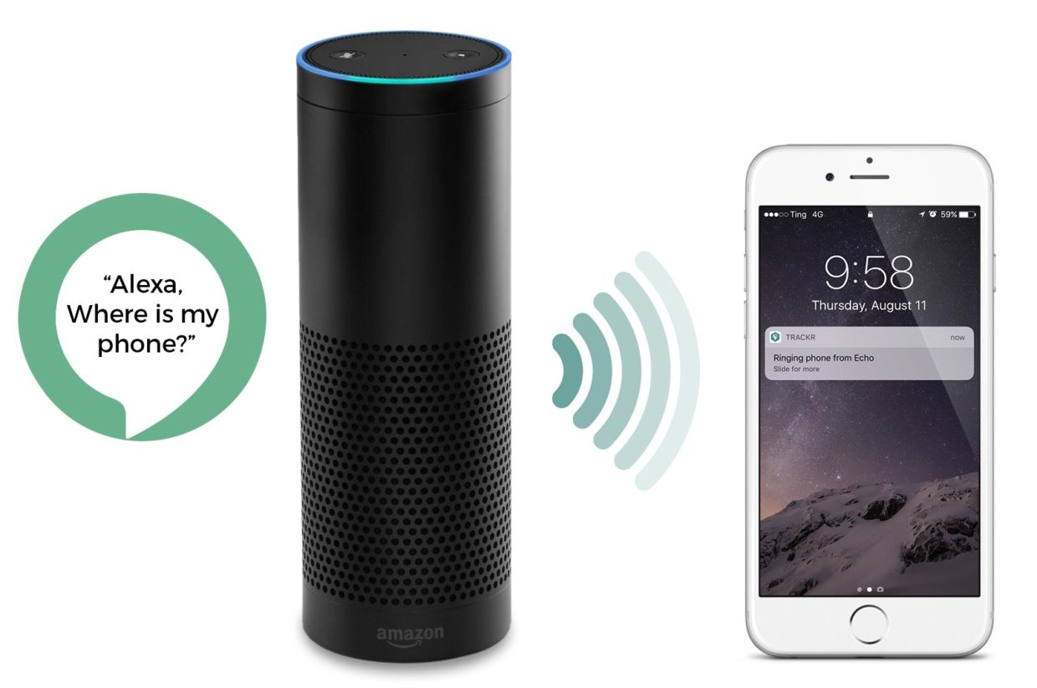
ChatBot Examples
Apple Siri
Amazon Alexa
Notes:
Siri from Apple and Alexa from Amazon also use same process.
The just added voice recognition technology.

Slide 5
SIMPLE ChatBot Examples
Predicción del tiempo
Comunidad local
Estudia idioma extranjero
Información de la tienda y pedido en línea
Universidad de ITSP ChatBot
Folleto público de la comunidad Cheran
Weather forecasting
Local community
Study foreign language
Store information & order online
ITSP college ChatBot
Cheran community public pamphlet
Notes:
They don’t process Natural Language.
That means, if you set all responses of limited number of questions, it will work well.

